Slide 1

Strategies for improving the assessment of probability of success (PoS) in late stage drug development
Lisa Hampson and Björn Holzhauer
19th February, 2021

Slide 2
Outline
Motivation and background
Overview of PoS framework
Key steps in the PoS assessment
Eliciting expert opinion on several related quantities of interest
Conclusions

Slide 3
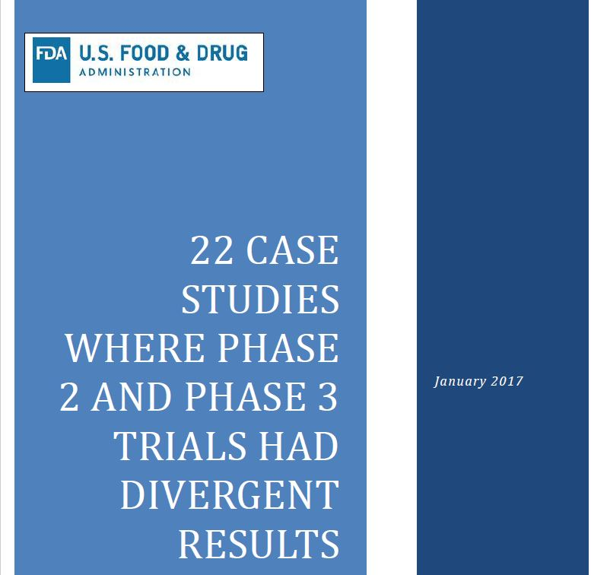

Promising results in smaller (early phase) trials are not always replicated by subsequent studies

Slide 4
What is “success” in Probability of Success (PoS)?
PoS is a metric quantifying the risk associated with key drug development decisions.
PoS accounts for our uncertainty about the (unknown) effect of a drug in a Bayesian framework.
We can calculate the PoS of a development program or an individual trial:
Trial level: Success is when a trial meets its statistical success criteria.

Slide 5
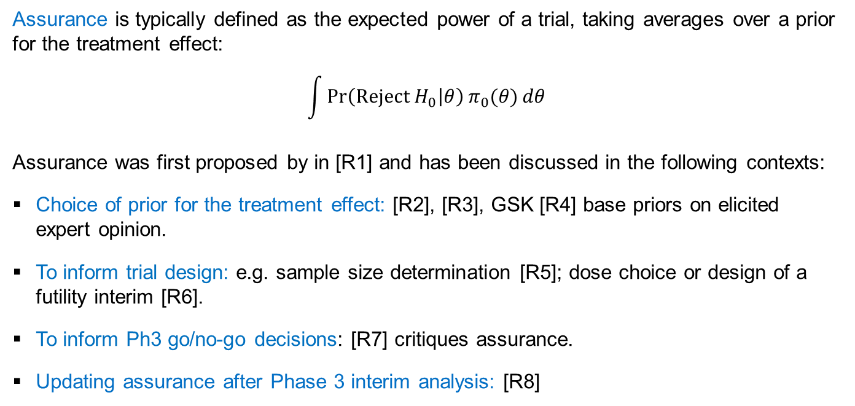
Probability of trial success (assurance)
Assurance is typically defined as the expected power of a trial, taking averages over a prior for the treatment effect:
$$\int{\operatorname{Pr}\left(\text{Reject} H_{0} | θ\right)π_{0}(θ)}dθ$$
Assurance was first proposed by in [R1] and has been discussed in the following contexts:
Choice of prior for the treatment effect: [R2], [R3], GSK [R4] base priors on elicited expert opinion.
To inform trial design: e.g. sample size determination [R5]; dose choice or design of a futility interim [R6].
To inform Ph3 go/no-go decisions: [R7] critiques assurance.
Updating assurance after Phase 3 interim analysis: [R8]

Slide 6
What is “success” in Probability of Success (PoS)?
PoS is a metric quantifying the risk associated with key drug development decisions.
PoS accounts for our uncertainty about the (unknown) effect of a drug in a Bayesian framework.
We can calculate the PoS of a development program or an individual trial:
Trial level: Success is when a trial meets its statistical success criteria.
Program level: Success is when a program achieves regulatory approval with key endpoints needed for market access in line with their target product profile (TPP).

Slide 7



“Success” is more than regulatory approval: We must also meet key endpoints of the TPP required for market access
END OF PH2
Launch
End
Expected commercial value =
Probability of “Success”
x
Potential value of “Success”
Peak sales
TPP
(pivotal)
Probability of Success within each Phase
60%
95%
70%
Sales forecasts assume that
key endpoints of TPP are met
Probability of Approval only ≠ PoS
60% * 95% = 57%
(potential gap)
Probability of Approval & TPP
60% * 95% * 70% = 40%
“Success” = Regulatory approval with key endpoints of TPP required for market access

Slide 8
Three of many possible ways to evaluate PoS
Benchmark-based
Based on few or many (ML) program characteristics ...
Followed by subjective adjustments based on team discussions.
Smart PoS framework
Combine benchmark & Ph2 data
If neccesary, bridge from Ph2 to Ph3 via expert elicitation
Use evidence to calculate probability of positive Ph3 trials meeting TPP targets
Assess risks beyond Ph3 via scorecard
Elicitation-based
Elicit experts’ beliefs about treatment effects informed by trial results, benchmarks, RWD ...
Calculate chance of positivie Ph3 trials
Data-based
Analyze Ph2 data, not allowing for any potential selection bias
Can only be applied when no differences between Ph2 & Ph3
Notes:
There are many ways of getting such a probability of success. I suspect the most common way is to simply use benchmarking techniques where the success rate accross industry is used. That may be based on a very few factors such as if the compond is developed for the first indication (NME) or follow-up indications (LCM). It could also use smarter techniques and more project level features, but it remains crude as it is not based on earlier results. Usually this is followed by a team discussion where you go up or down from the benchmark data based on any previous knowledge. This approach is fast and simple but also very subjective and non-transparent.
Another approach is to use expert elicitation to elicit treatment effects in Ph3 to derive a success criteria and this can be based on industry data, class specific data, and on previous trial results of this compound. This is a much more quantitative and structured approach.
We want to create even more transparency and put everything in a framework using benchmark information to inform priors, we use our Phase 2 data to predict Ph3, we may use expert elicitation to bridge over differences between Ph2 data and Ph3 design. Within the framework we can also add further risks using a score card method.

Slide 9
Schematic diagram of how we assess PoS at the end of Phase 2 by evaluating all key evidence in 4 incremental steps
Information added
How
PoS at end of Ph2
1
Step 1 PoS estimate
7 program characteristics
Predictive model based
on external industry data
2
Step 2 PoS estimate
Pivotal / Phase 3 risks
Bayesian analysis: strength
of evidence to meet TPP
Incremental PoS adjustment
3
Step 3 PoS estimate
Beyond Pivotal / Ph 3 risks
Adjustment algorithm
calibrated by experts
Exceptions only
4
Final PoS estimate
Unaccounted risks / data
Subjective adjustment

Slide 10
Key steps in the PoS evaluation

Slide 11

Recap: “Success” is regulatory approval with key endpoints of TPP required for market access
END OF PH2
TPP = target product profile
TPP
Phase 3
(pivotal)
Approval
What success means
Stat. significance on up to 2 key efficacy endpoints
No safety showstopper
Regulatory Approval
Meet TPP on key efficacy endpoints in pivotal trials
Meet all other TPP endpoints essential for market access

Slide 12
Step 1: Use industry data to derive tailored benchmark for the probability of approval at end of Ph2
Step 1 PoS estimate
1
7 program characteristics
Predictive models based on external industry data
Disease Area (11 categories)
Lifecycle Class (NME / LCM / Biosimilar)
Molecule Class (Protein / Small molecule / Other)
Drug Target (Receptor / Enzyme / Other)
Route of Administration (IV / IM / SQ / Other)
Size of Sponsor (Big Pharma / Other)
Breakthrough Status (Yes / No)
Considered:
Logistic regression
Lasso
Random forest
Neural network
Support Vector Machine

Slide 13
Step 2: Leverage clinical data to assess the chance of success in pivotal studies
Step 2 PoS estimate
2
Pivotal / Phase 3 risks
Bayesian analysis: strength
of evidence to meet TPP
Ph2 data
Design of pivotal trials

Slide 14
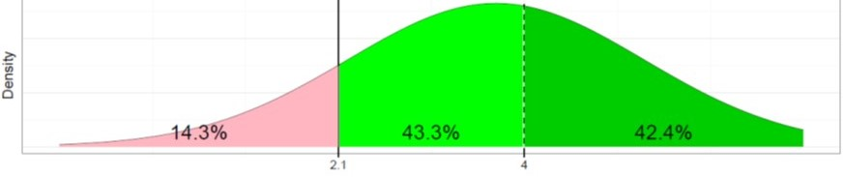
Combine external and project-specific data to assess the chance of success in pivotal trials
Use a Bayesian approach to quantify evidence at end of Ph2 about treatment effects on 1-2 efficacy endpoints.
Then simulate future pivotal trial(s)
... and assess the probability of meeting key efficacy success criteria.
Probability of no safety showstopper is based on industry benchmark and historical reasons for failure in Ph3.
Industry benchmark
(from Step 1)
42% chance meet TPP
86% chance of stat. significance
Phase 2 data
Probability
Updated evidence
Efficacy at end of pivotal study
Efficacy predictions

Slide 15
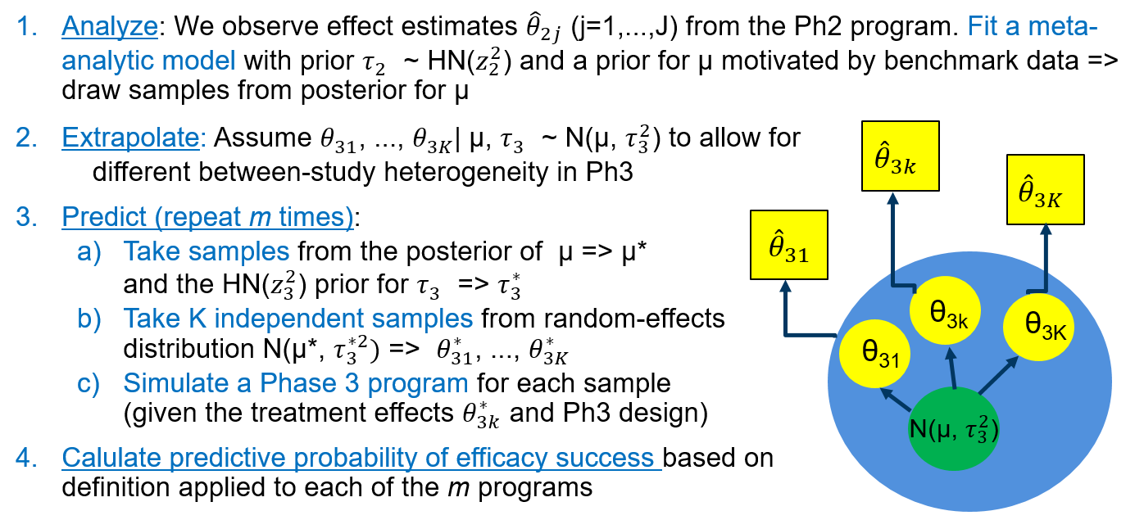
Account for between-trial heterogeneity in PoS calculation

Slide 16
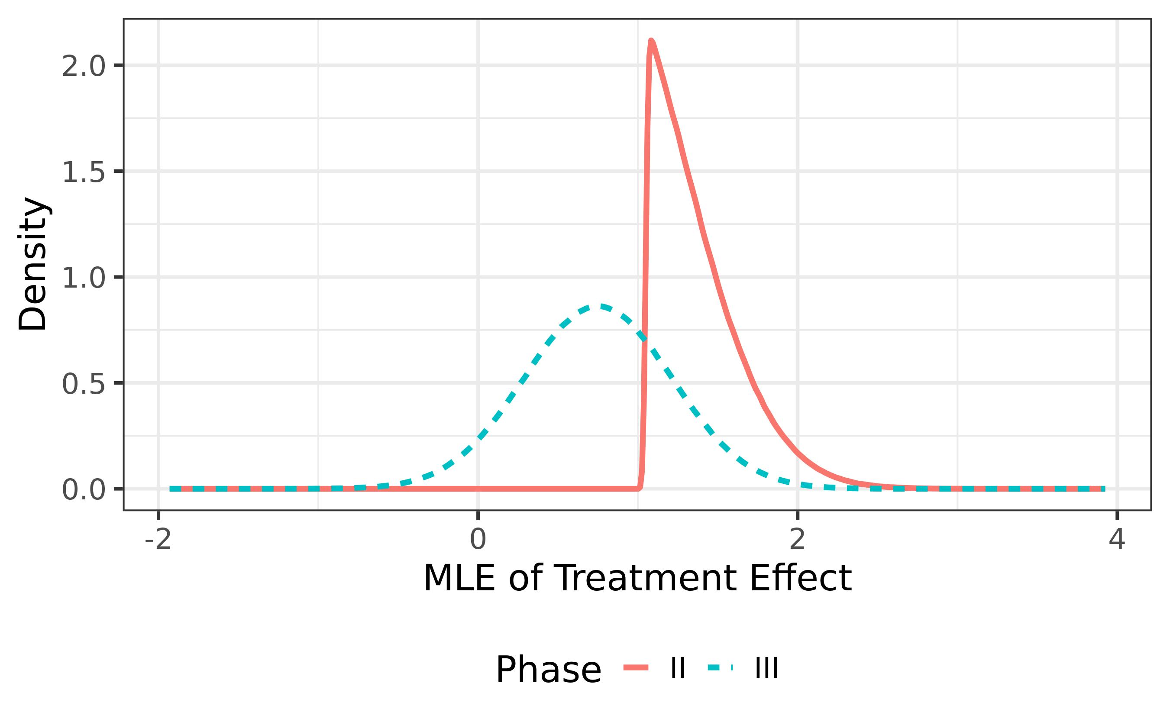
Selection bias in Phase 2 effect estimates
If we progress to pivotal trial only if we see a promising effect in Phase 2 data, we will likely see some regression towards the mean in pivotal studies.
Several possible solutions:
Analyze Phase 2 data using ‘Lump and Smear’ prior [R9, R10, R11].
Model the selection process [R12]
Discount the Ph2 effect estimate [R13]

Slide 17
Choose a prior for the average treatment effect μ to ameliorate impact of potential selection bias
Problem: We want a prior for μ satisfying the following requirements:
Prior should reflect some degree of skepticism
The degree of skepticism should be informed by historical success rates of similar projects at same stage of development
Impact of any shrinkage on the posterior should decrease as the Ph2 sample size increases and as the efficacy signal increases.
Solution: We use a mixture prior for μ with weights calibrated to industry benchmark chance of efficacy success in Ph2 and pivotal trials.

Slide 18
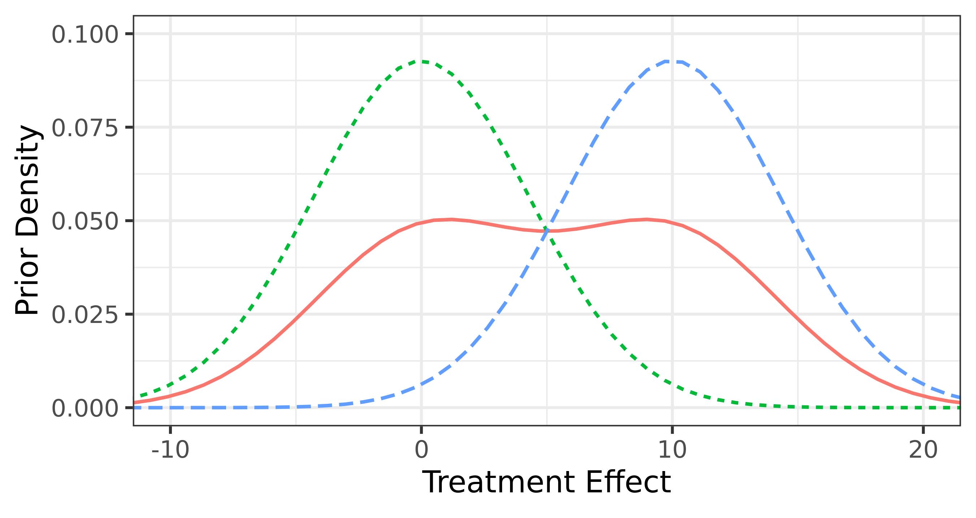
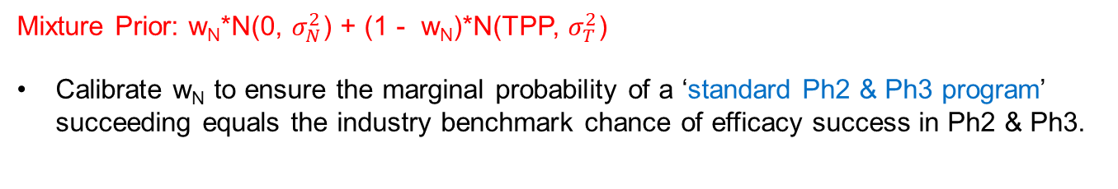
Specify prior for average effect μ which is mixture of two normal distributions
Null
TPP
Null component
Mean = null
P(μ > TPP) = 0.01
TPP component
Mean = TPP
P(μ < 0) = 0.01
Mixture
Mixture Prior: w_{N}*N(0, $σ_{N}^{2}$) + (1 - w_{N})*N(TPP, $σ_{T}^{2}$)
Calibrate w_{N} to ensure the marginal probability of a ‘standard Ph2 & Ph3 program’ succeeding equals the industry benchmark chance of efficacy success in Ph2 & Ph3.

Slide 19
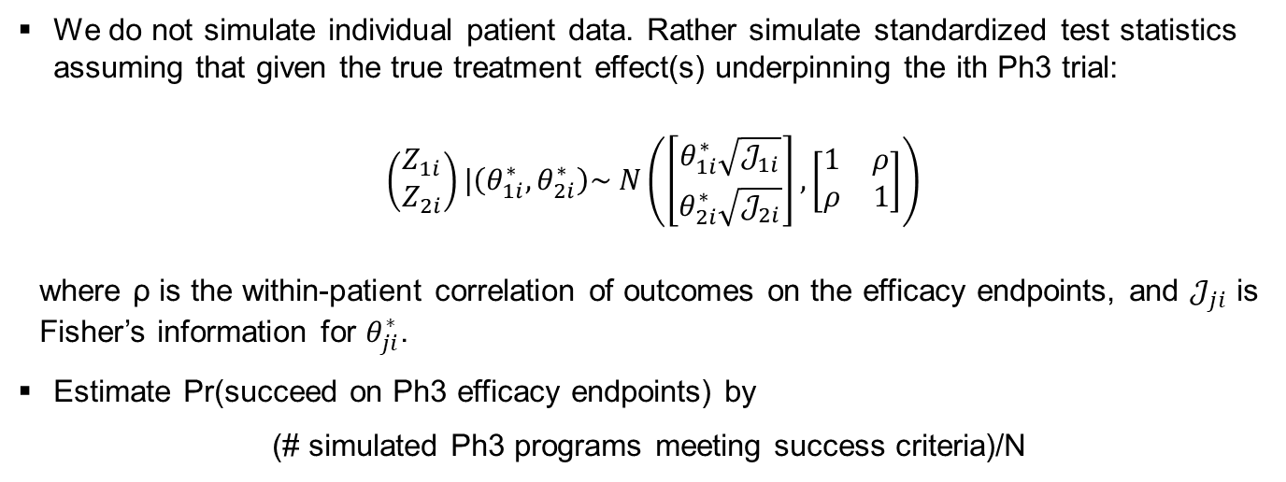
Simulate the future pivotal studies to calculate the predictive probability of efficacy success in Ph3
We do not simulate individual patient data. Rather simulate standardized test statistics assuming that given the true treatment effect(s) underpinning the ith Ph3 trial:
$\left(\begin{matrix}Z_{1i} \\ Z_{2i}\end{matrix}\right)|\left(θ_{1i}^{∗}, θ_{2i}^{∗}\right)\sim N\left(\left[\begin{matrix}θ_{1i}^{∗}\sqrt{𝒥_{1i}} \\ θ_{2i}^{∗}\sqrt{𝒥_{2i}}\end{matrix}\right], \left[\begin{matrix}1 & ρ \\ ρ & 1\end{matrix}\right]\right)$
where ρ is the within-patient correlation of outcomes on the efficacy endpoints, and $𝒥_{ji}$ is Fisher’s information for $θ_{ji}^{∗}$.
Estimate Pr(succeed on Ph3 efficacy endpoints) by
(# simulated Ph3 programs meeting success criteria)/N

Slide 20

Assessment of PoS is more complex when there are differences between Phase 2 and Phase 3 studies
Different phases can use different:
Endpoints
Patient populations
Comparator arms
Dose regimens
Relate Phase 2 data to pivotal quantities of interest by eliciting expert opinion.
We discuss this further in the 2nd part of the presentation.
Phase 2 data
Phase 3 Estimands
Source: Joe Cartoon

Slide 21
Step 3: Accounting for risks beyond pivotal studies
3
Step 3 PoS estimate
Beyond Pivotal / Phase 3 risks
Adjustment algorithm

Slide 22
Program team fills in scorecard rating their project on 5 risks
Rate project low / medium / high risk on:
Alignment with key regulator
Unaccounted safety risks
Quality & compliance risks
Technical development risks
Market access risks
Examples:
Non-endorsed primary endpoint
Safety risk found in pre-clinical study
Inexperienced sites to be used in Ph3
Different inhalers used in Ph2 & Ph3
Additional QoL endpoint required for access unlikely to meet TPP
Benchmark chance of success in submission (from Step 1) is adjusted according to risk profile. Adjustment is based on an elicitation survey involving 30 internal experts.

Slide 23
Step 4: In exceptional cases, apply an adjustment in case of risks / data unaccounted for in Steps 1-3
Final PoS estimate
4
Unaccounted risks / data
Subjective adjustment

Slide 24
Hypothetical example
Weight-loss drug called ThinFast
Small molecule, orally administered enzyme new molecular entity
Part of the metabolic therapeutic area
Health Authority has mild concerns regarding the plan to have a single Phase 3 study
Endpoint is “Weight Loss after 1 year (in kg)”
Used in both Phase 2b and Phase 3
Continuous endpoint: measured as difference in average change (vs placebo)
Null treatment effect: 0kg; TPP base case: 10kg
Standard deviation is known: 10kg
Promising Phase 2b result: 12kg, 95%-CI: (0kg,24kg)
One Phase 3 trial is planned
Sample size: 100 patients per arm
Testing at one-sided significance level of 0.025

Slide 25
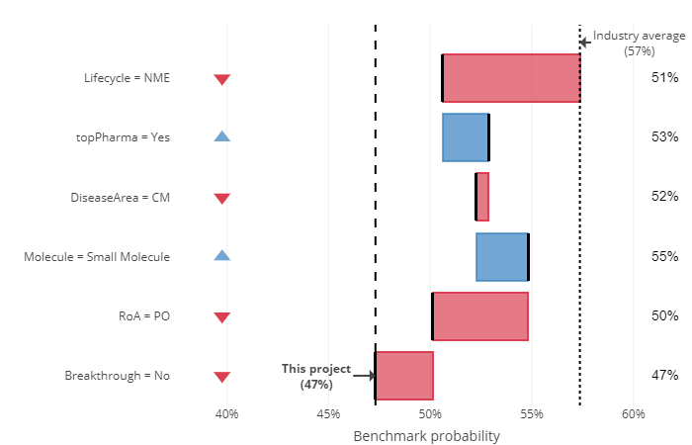
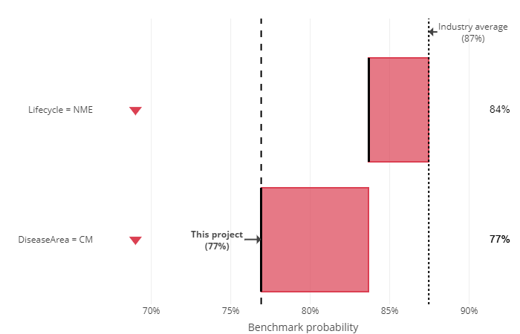
Example: Step 1 of the PoS assessment
Benchmark prob. of successful Ph3 = 47%
Benchmark prob. of approval after submission = 77%

Slide 26

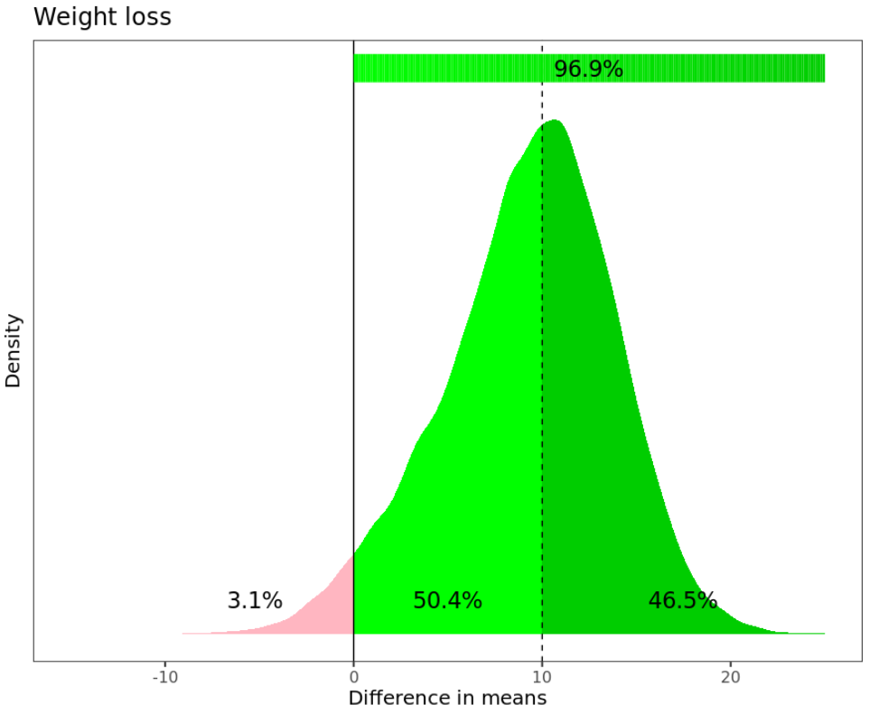
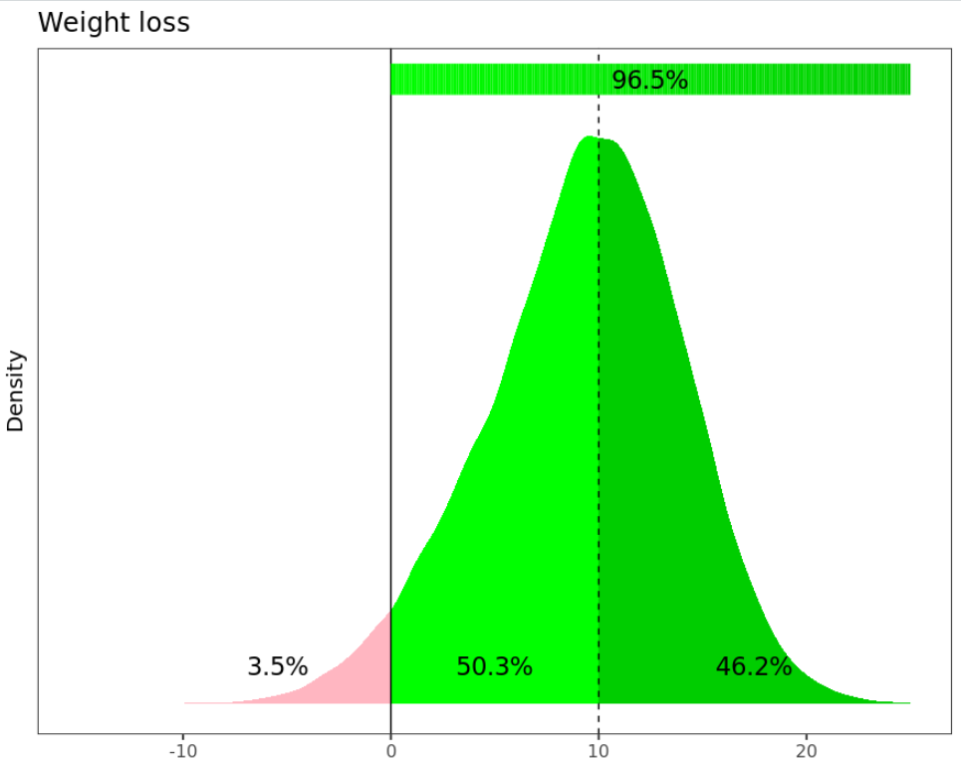
Example: Step 2 of the PoS assessment
Set-up prior – Mixture prior calibrated to 32% benchmark probability of efficacy success in Ph2b & Ph3 | Update prior with Ph2b data – Derive MAP prior for treatment effect in Ph3 given Ph2b result: estimate = 12kg, 95% CI (0kg, 24kg) | Predict Ph3 – Predictive distribution for the treatment effect estimate that will be observed at the end of Ph3. Prob of no safety showstopper = 92%
TPP
Difference in means
Effect estimate in Ph3

Slide 27
Example: Step 3 of the PoS assessment
Project was assigned the following risk ratings by the team:
Alignment with Key regulator: Medium
Unaccounted safety risks: Low
Quality & compliance risks: Low
Technical development risks: Low
Unaccounted TPP risks: Low
Given this information, Pr(Approval & TPP | Pivotal Efficacy, Safety) = 0.76
PoS = Pr(Pivotal Efficacy) * Pr(Pivotal Safety) * Pr(Approval & TPP | Pivotal Efficacy, Safety)
= 0.46 * 0.92 * 0.76
= 0.322

Slide 28
Eliciting expert opinion on several related quantities of interest

Slide 29
Elicitation: An example of a drug development program in asthma
Fevipiprant in asthma
Pilot for PoS framework at Novartis
PoS calculation finished just before database lock for Phase 3 studies
Avoids bias of knowing Phase 3 results (completely retrospective pilot)
Quick assessment of whether PoS and expert judgments made sense
But, more knowledge than when decision to start Phase 3 was taken
Fevipiprant 450 mg QD
LUSTER 1 (NCT02555683)
Fevipiprant 150 mg QD
Placebo
on top of standard of care
Fevipiprant asthma Ph3 program
Fevipiprant 450 mg QD
LUSTER 2 (NCT02563067)
Fevipiprant 150 mg QD
Placebo
on top of standard of care
Two identical pivotal Ph3 1-year exacerbation RCTs (2/3 of patients with high blood eosinophil counts)
Other studies (ZEAL 1 & 2, SPIRIT)

Slide 30
Definition of success used for this pilot: Efficacy criteria required elicitation
Statistical significance in both exacerbations studies
for one dose in both studies (same dose)
for both asthma exacerbations and FEV1
in high blood eosinophil count subgroup (comes first in testing procedure)
No unexpected safety finding
Approval
Point estimates meeting target product profile (TPP) goals
40% relative rate reduction (fixed effects meta-analysis of studies) for exacerbations
120 mL difference to placebo for FEV1 (fixed effects meta-analysis of studies)
Meeting other TPP goals

Slide 31
A successful elicitation meeting requires careful preparation
Defining the questions
Identifying the relevant evidence / assembling evidence dossiert
Selecting of experts
2 month process
12 June 2019
8 July 2019
20 July 2019
4 Nov 2019
28 May 2019
1 July 2019
12 July 2019
2 Aug 2019
Facilitator chosen
Workshop scheduled
Draft evidence dossier
Evidence dossier
Report
LPLV study 1
LPLV study 2
Workshop

Slide 32
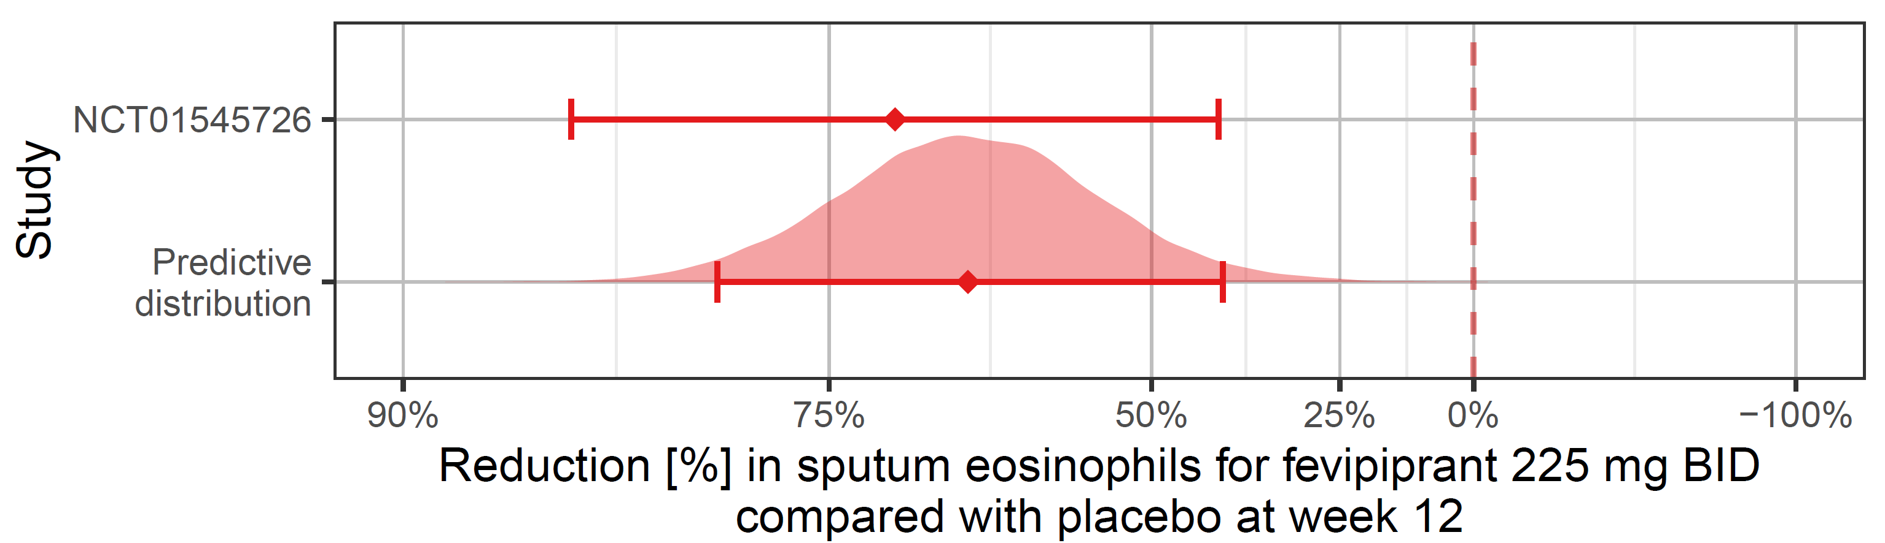
What evidence do we have on asthma exacerbations? (1/2)
Exacerbations: important from clinical, regulatory and commercial perspective
Little direct evidence, but a Phase 2 study showing an effect on a surrogate outcome (reduction sputum eosinophil counts in patients with elevated levels)

Slide 33
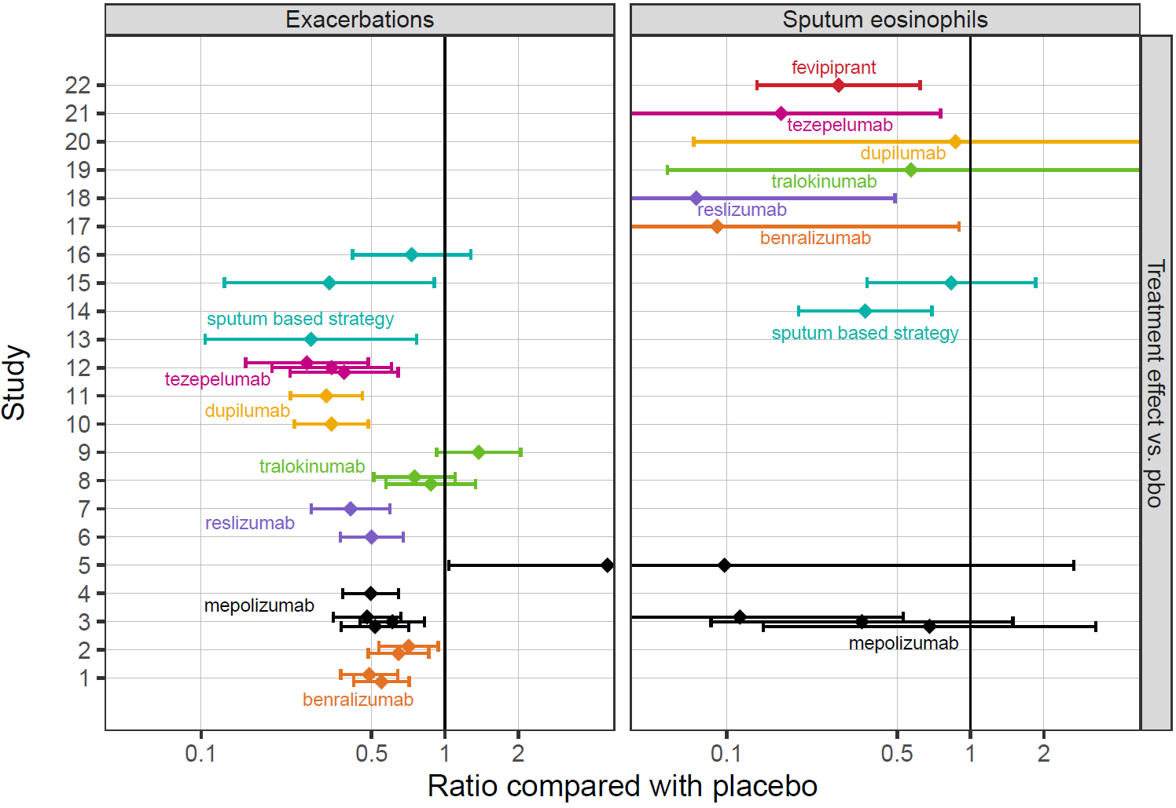
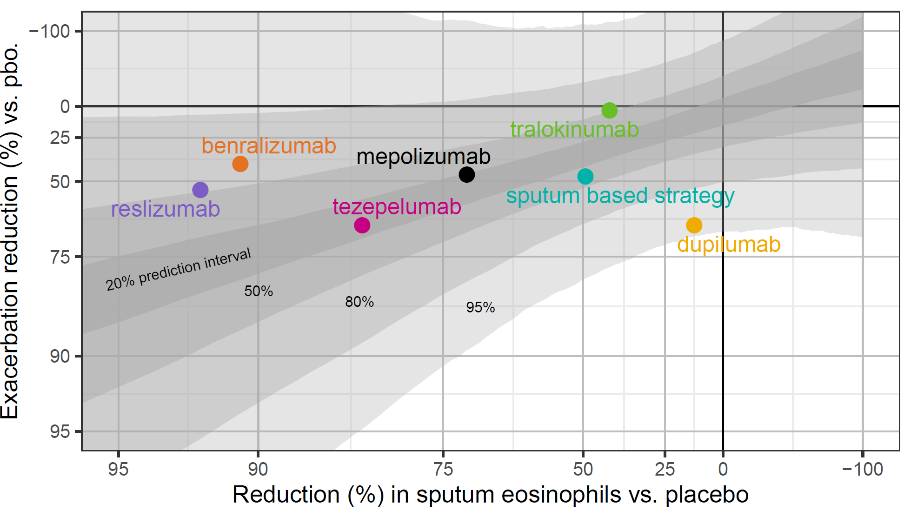
What evidence do we have on asthma exacerbations? (1/2)
Historical data of effect of drugs on surrogate and clinical outcome
Meta-regression

Slide 34
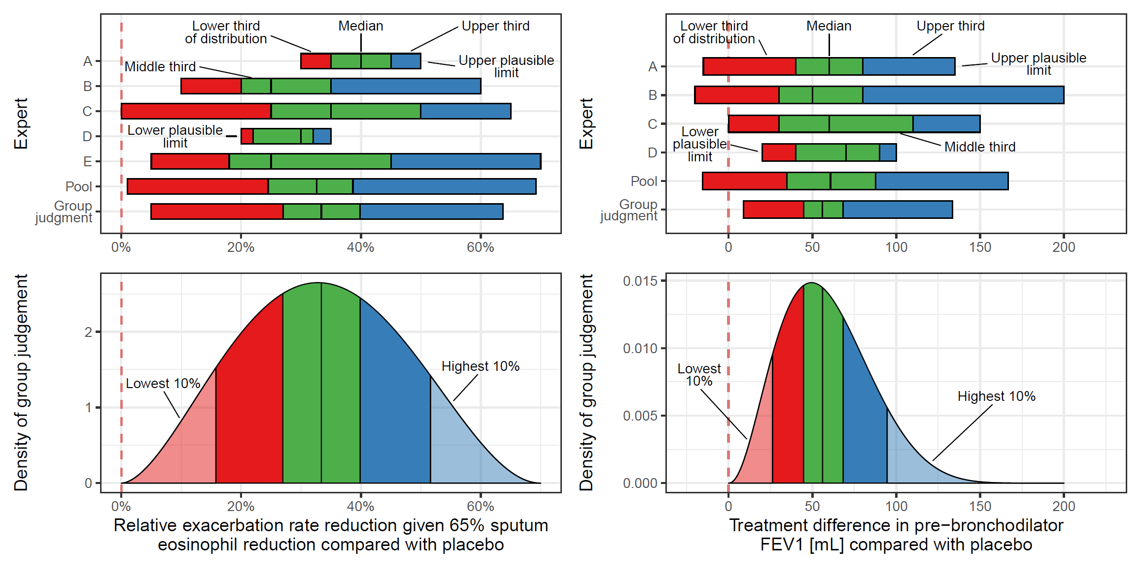
Elicitation for exacerbation rate reduction given median effect on surrogate
Start with individual judgments
Tertile method: in order of plausible limits, median, and then lower/upper tertile
Each expert writes down independently
“Challenge your judgment”
Individual judgments revealed to group
Group discussion
What would RIO (a Rational Impartial Observer) think? (probability method)

Slide 35
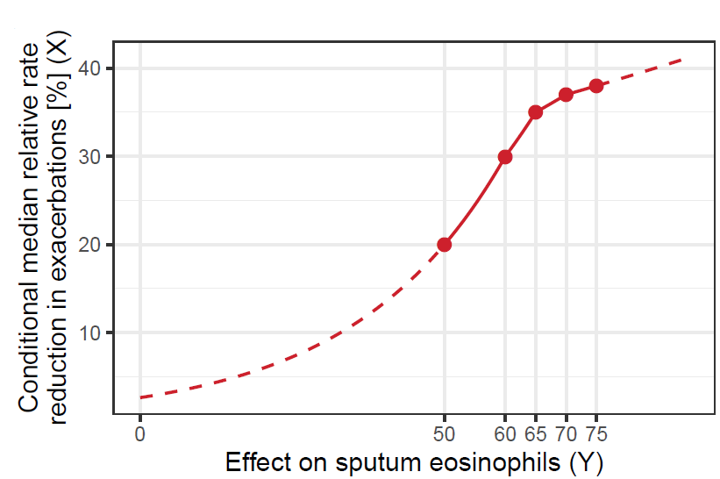
Extension method: Judgments conditional on given surrogate effects
Asked for their conditional judgement about the median percentage reduction in exacerbations given
effect on sputum eosinophils of 50%, 75%, 60% and 70%
≈10%, 90%, 25% & 75% points of marginal predictive dist. for sputum eosinophil effect
Piecewise linear function on the log-scale
Checked curve with experts

Slide 36
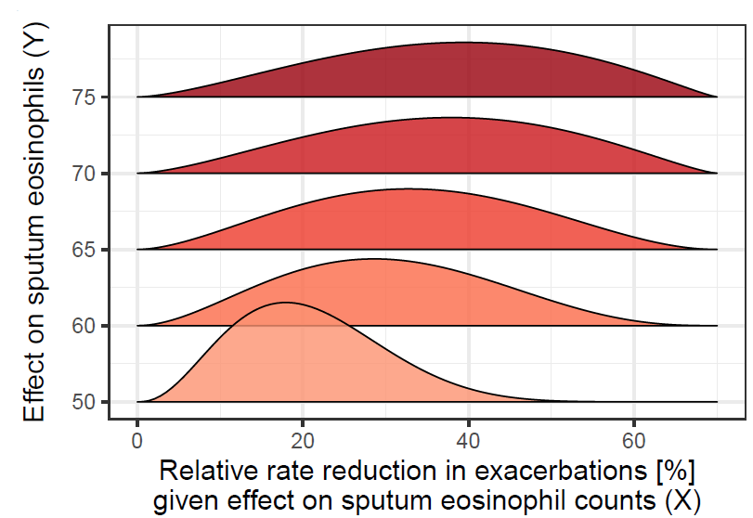
Extension method: Judgments on distributions at given surrogate effects
Used elicited distribution for effect conditional on median effect on sputum eos.
Shifted median of distributions based on previous slide
Assumed variance stays constant on the log-scale
Checked resulting predictions with experts

Slide 37
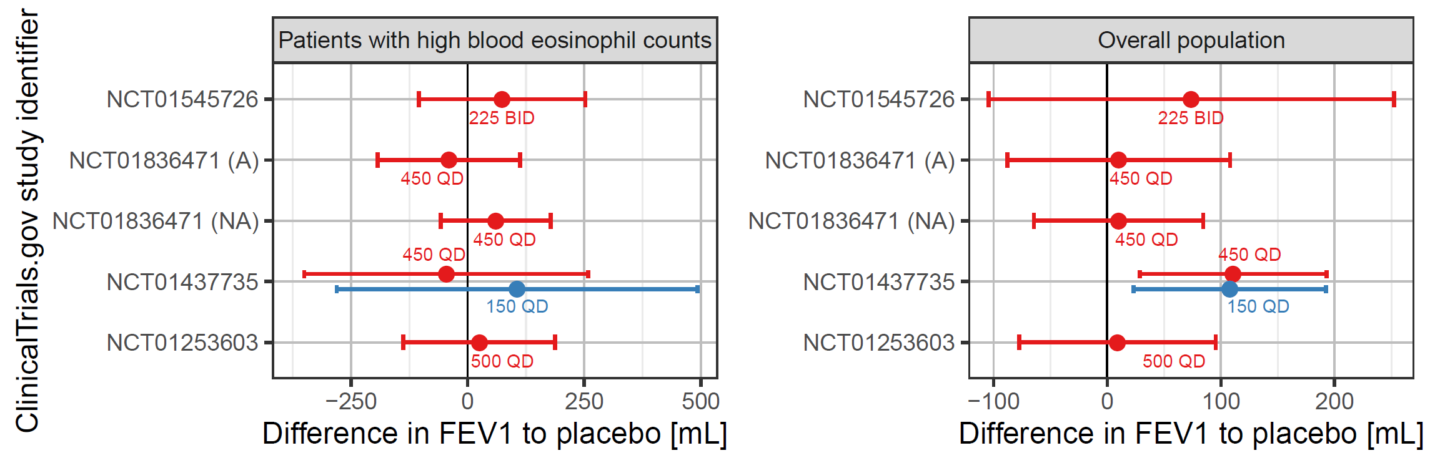
The evidence dossier: What data did we have on FEV1?

Slide 38
Elicitation for pre-bronchodilator FEV1: same process as for previous question
Start with individual judgments
Tertile method: in order of plausible limits, median, and then lower/upper tertile
Each experts writes down independently
“Challenge your judgment”
Individual judgments revealed to group
Group discussion
What would RIO (a Rational Impartial Observer) think? (probability method)

Slide 39
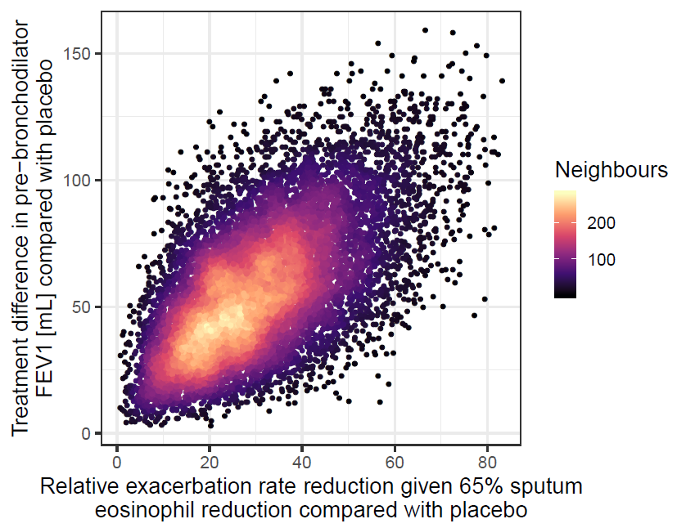
How correlated are experts’ judgments on drug effects on exacerbations and FEV1?
RIO's judgement of the concordance probability
Probability true values of effect on exacerbations & FEV1 are both on same side of elicited medians
Difficult to judge for experts
0.7 initially proposed
Alternatives visually displayed
Copula method to obtain joint distribution that fits this judgment

Slide 40
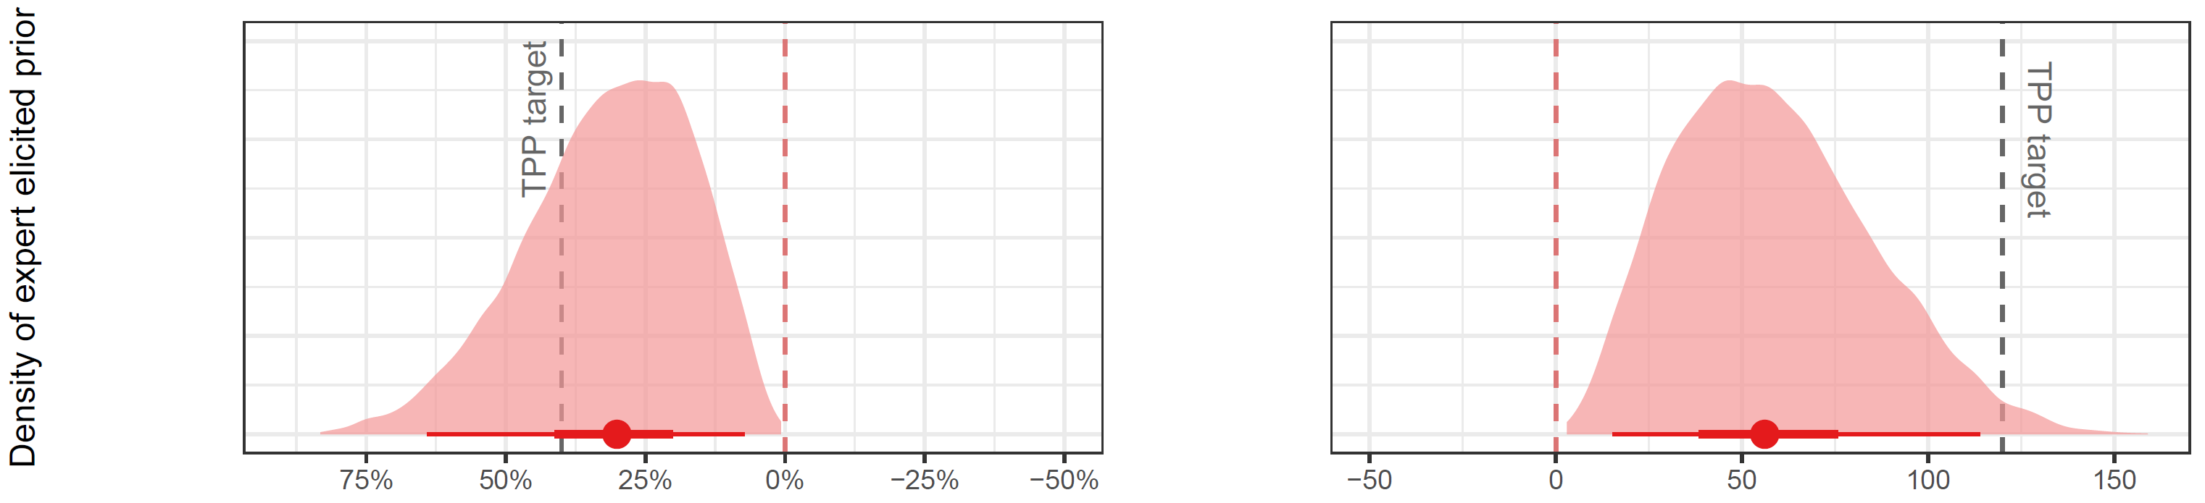
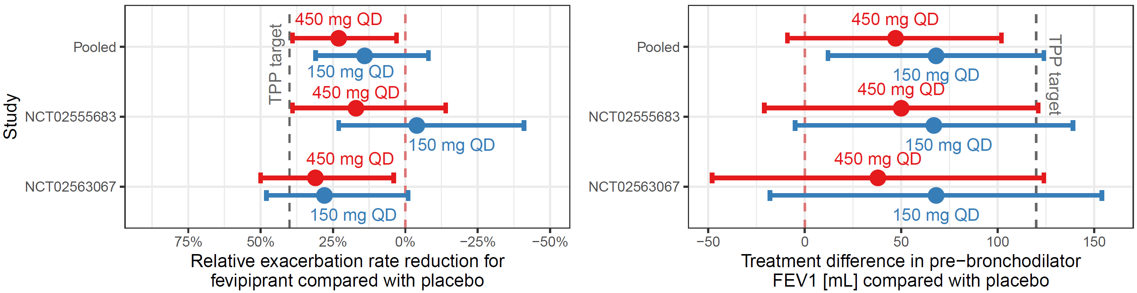
Calculated Probability of Success (PoS) and the final Phase 3 trial outcomes
Simulation of Ph3
Initial PoS: 4%
TPP ≥ 30% RRR & no FEV1: 41%
Exacerbations not significant after adjustment for multiplicity in either Ph3 trial
No filing pursued

Slide 41
Conclusions

Slide 42
Conclusions
PoS framework is currently being implemented within Novartis
Proposed methodology
produces more reliable PoS estimates which enable better decisions at a project & portfolio level
Increases transparency
Uses all available information from several sources
Provides insights on the impact of risk factors
If direct data are not available for a QoI, expert elicitation is an attractive solution, but requires a structured process and thorough preparation
Feedback from the experts: they found the evidence dossier a helpful resource in itself and appreciated the rigorous process and quality of the discussions

Slide 43
Acknowledgements
Novartis PoS team
Steffen Ballerstedt
Karine Baudou
Bjoern Bornkamp
Giovanni Della Cioppa
Wolfgang Kothny
Joseph Kahn
Markus Lange
Mustapha Larbaoui
Wen-Lin Luo
Pritibha Singh
Kelvin Stott
Michael Wittpoth
Our academic collaborators
Tony O’Hagan
John Paul Gosling

Slide 44
Bibliography
[R1] Spiegelhalter DJ, Freedman LS. A predictive approach to selecting the size of a clinical trial based on subjective clinical opinion. Statistics in Medicine 1986; 5:1-13
[R2] Rufibach K, Burger HU, Abt M. Bayesian predictive power: choice of prior and some recommendations for its use as probability of success in drug development. Pharmaceutical Statistics 2016; 15:438-46.
[R3] Lan KKG, Wittes JT. Some thoughts on sample size: A Bayesian-frequentist hybrid approach. Clinical Trials 2012; 9:561-69.
[R4] Crisp A, Miller S, Thompson D, Best N. Practical experiences of adopting assurance as a quantitative framework to support decision making in drug development. Pharmaceutical Statistics 2018; 17;317-28
[R5] O’Hagan A, Stevens JW, Campbell MJ. Assurance in clinical trial design. Pharmaceutical Statistics 2005; 187-201
[R6] Dallow N, Best N, Montague TH. Better decision making in drug development through adoption of formal prior elicitation. Pharmaceutical Statistics 2018; 17:301-16
[R7] Carroll KJ. Decision making from Phase II to Phase III and the probability of success: reassured by “assurance”? Journal of Biopharmaceutical Statistics 2013; 23:1188-1200
[R8] Rufibach K, Jordan P, Abt M. Sequentially updating the likelihood of success of a Phase 3 pivotal time-to-event trial based on interim analyses or external information. Journal of Biopharmaceutical Statistics 2016; 191-201

Slide 45
Bibliography
[R9] Spiegelhalter DJ, Abrams KR, Myles JP. Bayesian approaches to clinical trials and healthcare evaluation. John Wiley & Sons: 2004
[R10] Cornfield J. The Bayesian outlook and its application. Biometrics 1969; 25:617-57
[R11] Lachin JM. Sequential clinical trials for normal variates using interval composite hypotheses. Biometrics 1981; 37:87-101.
[R12]Bayarri MJ, Berger J. Robust Bayesian analysis of selection models. Annals of Statistics 1998, 26:645-59
[R13] Kirby S, Burke J, Chuang-Stein C, Sin C. Discounting phase 2 results when planning phase 3 clinical trials. Pharmaceutical Statistics 2012; 11; 373-85
[R14] Brightling, Christopher E., et al. "Effectiveness of fevipiprant in reducing exacerbations in patients with severe asthma (LUSTER-1 and LUSTER-2): Two phase 3 randomised controlled trials." The Lancet Respiratory Medicine 9.1 (2021): 43-56.
[R15] Hampson, Lisa V., et al. "Improving the assessment of the probability of success in late stage drug development." arXiv preprint arXiv:2102.02752 (2021).
[R16] Holzhauer, Björn, et al. "Eliciting judgements about dependent quantities of interest: The SHELF extension and copula methods illustrated using an asthma case study." arXiv preprint arXiv:2102.02852 (2021).
[R17] Jeremy E. Oakley and Anthony O'Hagan. SHELF: the Sheffield Elicitation Framework (version 4). School of Mathematics and Statistics, University of Sheffield, UK, 2019. Available at http://tonyohagan.co.uk/shelf.

Slide 46


